Slide 1


Single Bureau Galaxy
IT OPS -KT

Slide 2


Agenda
Galaxy Architecture
Galaxy Environment /Infrastructure
Galaxy Pipelines
Monitoring/Alerts
Questionaries

Slide 3
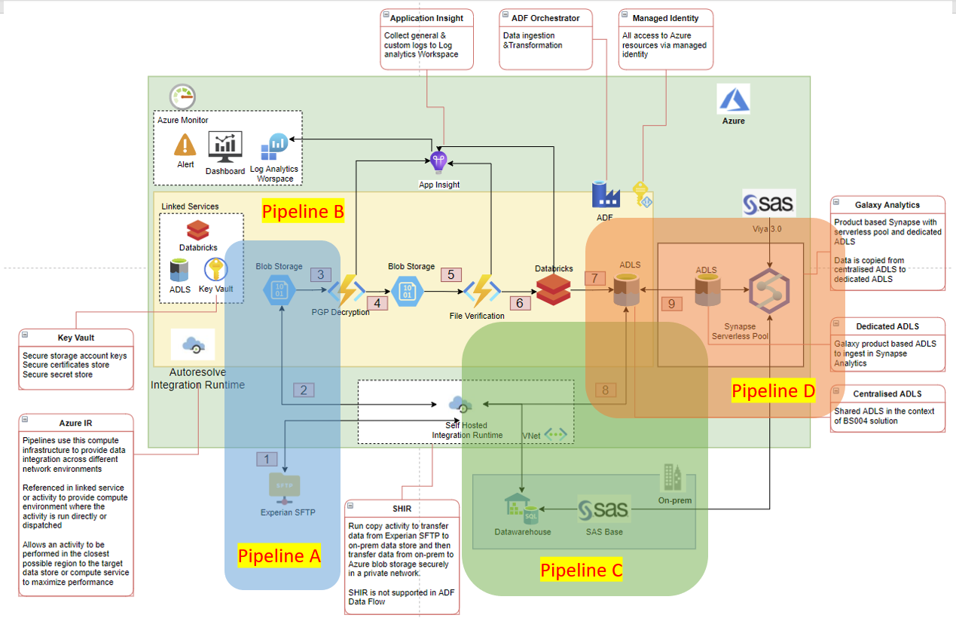

Slide 4
Some Important Links
GalaxySingleBureauPipelinesProcess - Overview (visualstudio.com)
Monitoring & Troubleshooting - Overview (visualstudio.com)
Infrastructure As Code (IaC) - Overview (visualstudio.com)
Code location
DataPlatform.Galaxy
Experian Files Loading to Galaxy Datalake (Pipeline A & B)
DataPlatform.SBP
Load selected and derived columns to on-prems data warehouse (Pipeline C)
DataPlatform.Galaxy.Synapse
Create Synapse Galaxy DW in Azure Cloud (Pipleine D)

Slide 5
Metrics
FILES | VOLUME | RECORD COUNT | PROCESSING TIME
CACC ( 5 segs ) | 180 G | 19684610,22440140, 22457694,16183807,10451042 | 30-60 Mins per file
CAPS | 1.22 G
CCAF | 29.48 G
EROL | 254.1 M
HSH | 12.35 G
PUIN | 251 M
TOTL | 13.1 G

